Slide 1
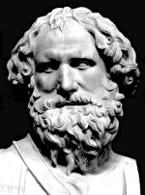
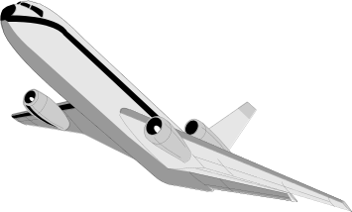
powerpointmaths.com
3:2
Quality resources for the mathematics classroom
Reduce your workload and cut down planning
Enjoy a new teaching experience
Watch your students interest and enjoyment grow
Key concepts focused on and driven home
Over 100 files available with many more to come
1000’s of slides with nice graphics and effects.
powerpointmaths.com
Get ready to fly!
© Powerpointmaths.com All rights reserved.

Slide 2

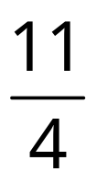




Improper Fractions to Mixed Numbers
¼
¼
¼
¼
¼
¼
¼
¼
¼
¼
¼
¼
¼
¼
¼
¼
¼
2¾
¼
¼
¼
¼
¼
1
2

Slide 3


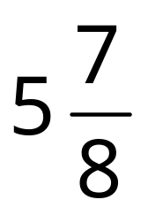
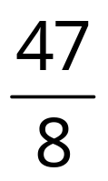
Mixed Numbers To Improper Fractions
3½
2¾

Slide 4
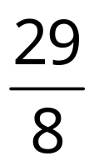





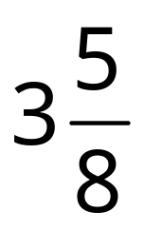

Improper Fractions to Mixed Numbers
1
2
3

